Slide 1

Scope & Problem
Customer Details
Data Design
Management System
Table Schema
Database Systems · Individual Project · Banking Domain
SQL Queries
Submitted by:
[MURUNGI EMMANUEL JOSHUA]
Insights & Analysis
[2025/BCS/128/PS] · · 6th May 2025

Slide 2
What Is the Customer Details Management System?
PROJECT OVERVIEW
Definition: database solution designed to manage identity, biographical, and account information within a banking institution.. It serves as the authoritative source of truth for all customer-facing operations.
"As Database Designer,
I engineered a normalized schema across six
tables—customer_bio, account_details, branch_details, loan_records,
customer_contact, and transaction_history—linking them via Foreign Keys to enforce referential integrity. I optimized the physical design using DECIMAL for
financial accuracy and ENUM for consistency, ensuring a secure, scalable banking
architecture that eliminates data redundancy."
The Context
The Gap This Fills
My role as the database designer
Banks interact with thousands of customers daily. Each interaction — whether opening an account, processing a payment, or issuing a loan — depends on accurate, instantly accessible customer data. Without a centralised system, this data lives in spreadsheets, paper files, and disconnected registers.
This project implements a normalised MySQL database with 6 core tables — customer_bio, transaction_history ,branch_details loan_records, customer_contact and account_details — that create a complete, queryable, and auditable view of every customer .
Customer Details Management System · Database Systems Project
2 / 14

Slide 3
The Problem This System Solves
PROBLEM STATEMENT & MOTIVATION
Challenges of file-based systems
WITH a CDMS — What Changes
1. Data Fragmentation Customer records exist in paper files, Excel sheets, and multiple disconnected systems across branches. A customer at Branch 101 is invisible to Branch 105.
✓ Unified Customer Record One customer_id links all data: biography, account(s), contact details, and transaction history — regardless of which branch the customer visits.
2. No Single Customer View The same person may be registered multiple times under slightly different names, making portfolio analysis, AML checks, and credit assessments unreliable.
✓ Enforced Data Integrity Primary and foreign key constraints, NOT NULL fields, CHECK constraints, and ENUM types ensure data quality is enforced at the database level, not just by staff discipline.
3. KYC Non-Compliance Bank of Uganda requires structured KYC records. Manual systems cannot produce verifiable audit trails, exposing banks to regulatory sanctions.
✓ Instant Regulatory Reporting KYC data is structured and queryable. A compliance officer can extract all customer records within seconds — satisfying Bank of Uganda inspection demands.
4. Slow Customer Service Tellers spend 15–30 minutes locating a customer's file. This creates queues, customer frustration, and operational inefficiency.
✓ Sub-second Query Response SQL queries on indexed columns return full customer profiles in under a second, reducing teller service time from 30 minutes to under 2 minutes.
5. Zero Analytical Insight Management cannot run queries like 'how many active savings accounts are at Branch 101?' or 'what is the average balance of female customers?' without a structured DB.
✓ Rich Management Analytics Queries on gender, account_type, balance ranges, branch distribution, and account status turn raw records into actionable business intelligence.
Customer Details Management System · Database Systems Project
3 / 14

Slide 4
System Objectives & Scope
OBJECTIVES · SCOPE · ASSUMPTIONS
01
Capture & Store
02
Link & Relate
03
Enforce Integrity
Provide a structured schema for storing complete customer biographical and account data with full data type enforcement and normalisation to 3NF.
Establish a one-to-many relationship between customers and accounts via a foreign key on customer_id, enabling portfolio queries across all accounts.
Use primary keys, foreign keys, UNIQUE constraints on account_number, and CHECK constraints on balance (≥ 0) to guarantee data correctness.
04
Enable Analytics
05
Support Compliance
06
Scale with Growth
Support SQL aggregate queries (COUNT, AVG, SUM, GROUP BY) to give management real-time insight into customer distribution, balances, and account status.
Structure KYC-relevant fields (date_of_birth, national_id, gender, email) in a queryable form that satisfies Bank of Uganda regulatory requirements.
Design the schema to accommodate thousands of customer records with consistent performance using indexes on customer_id and account_number.
Customer Details Management System · Database Systems Project
4 / 14

Slide 5
Database Schema Design & Normalisation
ENTITY RELATIONSHIPS · NORMALISATION · DESIGN DECISIONS
TABLE: customer_bio
TABLE: account_details
customer_id
VARCHAR(20)
🔑 PK
account_number
INT
🔑 PK
first_name
VARCHAR(50)
✓
customer_id
VARCHAR(20)
🔗 FK
last_name
VARCHAR(50)
✓
account_type
ENUM(savings,current)
✓
1 : N
date_of_birth
DATE
✓
FK →
balance
DECIMAL(12,2)
⚡ CHECK
gender
ENUM(m,f)
✓
currency
CHAR(3)
✓
email
VARCHAR(100)
◆ UNIQ
branch_id
INT
✓
status
ENUM(Active,Inactive)
✓
3NF Compliance: Both tables satisfy Third Normal Form — no transitive dependencies. customer_bio stores only personal data; account_details stores only account data. The relationship is enforced via FK on customer_id.
Customer Details Management System · Database Systems Project
5 / 14

Slide 6
Deep Dive: customer_bio Table
ATTRIBUTE ANALYSIS · DESIGN RATIONALE · SAMPLE DATA
customer_id
first_name / last_name
VARCHAR(20)
VARCHAR(50)
Serves as the Primary Key and the link between all customer-related tables. Uses a formatted string pattern (CID-YYYY-NNNN) to embed the registration year, making records self-describing and human-readable for audit purposes.
Stored separately (not concatenated) to enable flexible search by either name component, alphabetical sorting by last_name, and future salutation logic without string parsing.
date_of_birth
gender
DATE
ENUM('m','f')
Stored as a DATE type (not VARCHAR) to enable age calculations (DATEDIFF), KYC age-verification checks, and compliance with Bank of Uganda's requirement to identify underage account holders.
ENUM enforces a controlled vocabulary — only 'm' or 'f' are accepted, preventing free-text inconsistencies like 'Male', 'male', 'M', 'MALE'. This is critical for demographic reporting accuracy.
email
Completeness Note
VARCHAR(100)
Future Additions
Marked UNIQUE to prevent two customers from sharing an email address — which would make digital banking login and password recovery ambiguous. NULL is allowed for customers without email access.
Production schema would add: phone_number, national_id (UNIQUE), address, kyc_status ENUM, date_registered DATETIME, and a self-referencing relationship for joint account holders or corporate signatories.
Customer Details Management System · Database Systems Project
6 / 14

Slide 7
Deep Dive: account_details Table
ATTRIBUTE ANALYSIS · BUSINESS LOGIC · DATA DISTRIBUTION
account_number
customer_id
INT / PK
VARCHAR(20) / FK
An integer PK auto-incremented from 10012001. Numeric PKs on account tables are standard in banking — they index faster than VARCHAR and match the format customers see on their physical bank cards.
Foreign Key referencing customer_bio.customer_id. This enforces referential integrity — you cannot insert an account for a customer_id that does not exist in the customer_bio table. ON DELETE RESTRICT prevents orphaned accounts.
account_type
balance
ENUM('savings','current')
DECIMAL(12,2)
ENUM restricts values to 'savings' or 'current', the two most common retail account types. Savings accounts earn interest but have withdrawal limits; current accounts offer overdraft facilities for business customers.
DECIMAL is used instead of FLOAT/DOUBLE because floating-point types introduce rounding errors in financial calculations. DECIMAL(12,2) supports balances up to $9,999,999,999.99 with cent-level precision.
branch_id
status
INT / FK
ENUM('Active','Inactive')
References the Branch table (not in current scope but implied). Storing branch_id enables filtering accounts by branch, generating branch-level reports, and enforcing branch-specific policies on account types and limits.
Rather than deleting closed accounts (which would destroy audit history), accounts are marked 'Inactive'. This is the soft-delete pattern — preserving all transaction history while removing the account from active operations.
Customer Details Management System · Database Systems Project
7 / 14

Slide 8
SQL DDL — CREATE TABLE Statements
These CREATE TABLE statements define the physical schema. Every design decision — data types, constraints, keys — is deliberate and production-grade.
-- ══════════════════════════════ -- TABLE 1: Customer Biography -- ══════════════════════════════ CREATE TABLE customer_bio ( customer_id VARCHAR(20) NOT NULL PRIMARY KEY, first_name VARCHAR(50) NOT NULL, last_name VARCHAR(50) NOT NULL, date_of_birth DATE NOT NULL, gender ENUM('m','f') NOT NULL, email VARCHAR(100) UNIQUE ); -- Index for fast lookup CREATE INDEX idx_cust_name ON customer_bio(last_name);
-- ══════════════════════════════ -- TABLE 2: Account Details -- ══════════════════════════════ CREATE TABLE account_details ( account_number INT PRIMARY KEY, customer_id VARCHAR(20) NOT NULL, account_type ENUM('savings','current') NOT NULL, balance DECIMAL(12,2) NOT NULL CONSTRAINT chk_balance CHECK (balance >= 0), currency CHAR(3) DEFAULT 'USD', branch_id INT NOT NULL, status ENUM('Active','Inactive') DEFAULT 'Active', FOREIGN KEY (customer_id) REFERENCES customer_bio(customer_id) ON DELETE RESTRICT );
Customer Details Management System · Database Systems Project
8 / 14

Slide 9
Data Population — INSERT Statements & Error Analysis
DML · SAMPLE DATA · DATA QUALITY OBSERVATIONS
Sample INSERT — customer_bio
⚠ Errors Found in Raw INSERT Data
INSERT INTO customer_bio (customer_id, first_name, last_name, date_of_birth, gender, email) VALUES ('CID-2024-1001','James','Smith', '1985-01-12','m', 'james.smith@email.com'), ('CID-2024-1007','Michael','Matovu', '1982-02-14','m', 'mike.m@email.com'), -- ... 29 records total ('CID-2024-1030','Ashley','Robinson', '1996-09-20','m', 'ash.r@email.com');
CID-2024-1011
Missing opening quote in email field — dave.h@email.com' should be 'dave.h@email.com'. SQL syntax error; INSERT would fail.
CID-2024-1012
Trailing comma after last value field — ('barb.l@email.com',) — extraneous comma causes syntax error in strict SQL mode.
CID-2024-1017
Double comma (,,) before date_of_birth — 'Tom','Tuhaise',,'1986...' — this NULL placeholder is invalid syntax; would require explicit NULL.
CID-2024-1023
Trailing comma after last column value — same as CID-1012. Must be removed before execution.
CID-2024-1028
Columns are in wrong order — email appears where date_of_birth should be. Data type mismatch would cause implicit conversion error or INSERT failure.
account_details
Account 10012015 is missing — gap in sequence between 10012014 and 10012016. Possibly deleted before export; should be investigated for audit trail.
29
Customer Records Inserted
29
Account Records Inserted
1
Inactive Account (CID-1006)
5
SQL Errors in Raw Data
Customer Details Management System · Database Systems Project
9 / 14

Slide 10
SQL Queries — Retrieval & Analysis (Part 1)
Each query below addresses a real operational need. The JOIN pattern linking customer_bio to account_details is the system's most powerful feature.
Q1 — Full Customer Profile (JOIN both tables)
Q2 — All Active Accounts with Balance > $5,000
Purpose: Operational need: A teller needs the complete record of a customer — both personal data and account summary — in a single query.
Purpose: Management need: Identify high-value customers for premium product offerings or relationship manager assignment.
SELECT cb.customer_id, cb.first_name, cb.last_name, cb.gender, cb.email, ad.account_number, ad.account_type, ad.balance, ad.status, ad.branch_id FROM customer_bio cb INNER JOIN account_details ad
ON cb.customer_id = ad.customer_id WHERE cb.customer_id = 'CID-2024-1001';
SELECT cb.first_name, cb.last_name, ad.account_number, ad.account_type, ad.balance, ad.branch_id FROM customer_bio cb JOIN account_details ad
ON cb.customer_id = ad.customer_id WHERE ad.balance > 5000 AND ad.status = 'Active' ORDER BY ad.balance DESC;
Customer Details Management System · Database Systems Project
10 / 14

Slide 11
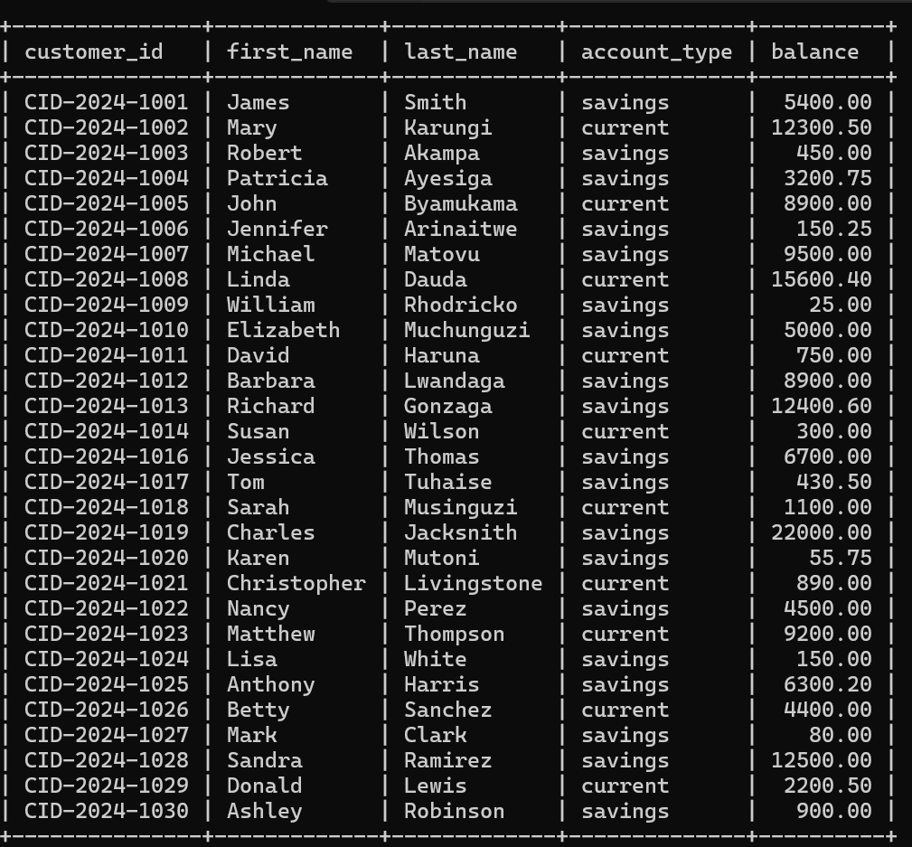
1A query joining names and balance. Here I linked two tables using the foreign key and produced a list of customers showing their names and their current bank balance

Slide 12
SQL Queries — Aggregation & Analytics (Part 2)
Aggregate queries transform raw records into management intelligence — the true value of a structured database over a spreadsheet.
Q3 — Account Summary by Branch (Management Dashboard Query)
SELECT ad.branch_id,
COUNT(*) AS total_accounts,
SUM(ad.balance) AS total_deposits_usd,
AVG(ad.balance) AS avg_balance_usd,
SUM(CASE WHEN account_type='savings' THEN 1 ELSE 0 END) AS savings_count,
SUM(CASE WHEN account_type='current' THEN 1 ELSE 0 END) AS current_count FROM account_details ad GROUP BY ad.branch_id ORDER BY total_deposits_usd DESC;
Q4 — Gender & Age Distribution of Customers (Demographic Analytics)
SELECT gender,
COUNT(*) AS total_customers,
AVG(TIMESTAMPDIFF(YEAR, date_of_birth, CURDATE())) AS avg_age,
MIN(TIMESTAMPDIFF(YEAR, date_of_birth, CURDATE())) AS youngest_age,
MAX(TIMESTAMPDIFF(YEAR, date_of_birth, CURDATE())) AS oldest_age FROM customer_bio GROUP BY gender;
Expected Q3 Result (from data): Branch 101 has the most accounts (9). Branch 105 has the highest avg balance ($15,450). Expected Q4 Result: 15 male customers (avg age ~37) · 14 female customers (avg age ~35) · Ashley Robinson (1996) is youngest · Linda Dauda (1975) is oldest
Customer Details Management System · Database Systems Project
11 / 14

Slide 13
Data Insights — What the Dataset Reveals
ANALYTICAL OBSERVATIONS FROM ACTUAL DATA
Key Dataset Insights
Total Accounts:
29 records
Active Accounts:
28 (96.6%)
Inactive Accounts:
1 (CID-1006)
Savings Accounts:
21 (72.4%)
Current Accounts:
8 (27.6%)
Total Deposits:
~$183,000
Average Balance:
~$6,312
Highest Balance:
$22,000 (C-1019)
Lowest Balance:
$25.00 (C-1009)
Observation: The dataset shows a healthy 96.6% account activity rate. The $25 minimum balance (CID-1009) likely reflects a micro-savings customer — a common segment in Ugandan banking that requires low-minimum-balance products. The gap at account 10012015 should be investigated as a potential data integrity issue.
Customer Details Management System · Database Systems Project
12 / 14

Slide 14
System Limitations & Future Enhancements
HONEST ASSESSMENT · PRODUCTION ROADMAP
Missing National ID Field
No Password / Auth Layer
L1
The national_id field is absent from customer_bio, yet Bank of Uganda's KYC requirements mandate it. Without it, identity verification at account opening cannot be enforced at the database level.
L2
customer_bio stores no login credentials, PIN, or 2FA data. A production system requires a separate auth table with hashed passwords (bcrypt), failed_attempts counter, and session token management.
No Audit Log Table
L3
Single Currency Only
L4
L3
Changes to customer data (address updates, email changes, status changes) are not tracked. A production system requires an Audit_Log table recording table_name, record_id, action, old_value, new_value, changed_by, and timestamp.
All accounts are in USD, with no currency_id FK to a Currency reference table. A real bank serving Ugandan customers would need UGX as the base currency, with multi-currency support for USD and KES accounts.
No Branch Table
L3
L5
branch_id in account_details references a branch that doesn't exist as a table in the current schema. This FK relationship is implied but not enforced, creating a dangling reference.
Customer Details Management System · Database Systems Project
13 / 14

Slide 15



Conclusion & Takeaways
What Was Built
What It Solves
What Was Learned
A fully normalised MySQL relational database with two production-grade tables — customer_bio and account_details — linked via a foreign key. The schema enforces data integrity through PKs, FKs, ENUMs, CHECK constraints, and UNIQUE fields, making it a robust foundation for a real banking system.
The system eliminates the fragmentation, duplication, and unqueryability of manual customer data management. It provides instant, accurate retrieval of customer profiles, enables management analytics via SQL aggregations, and creates a structured platform for KYC compliance and digital banking services.
Building this system demonstrated that database design is not just about storing data — it is about encoding business rules, relationships, and constraints directly into the schema. The five SQL errors found in the raw INSERT data illustrate that data quality at entry is as critical as schema design.
The Customer Details Management System demonstrates that a well-designed relational database is the backbone of every banking operation — from a single teller query to enterprise-level compliance reporting.
[Your Name] · [Reg. Number] · Database Systems · May 2025

Slide 16
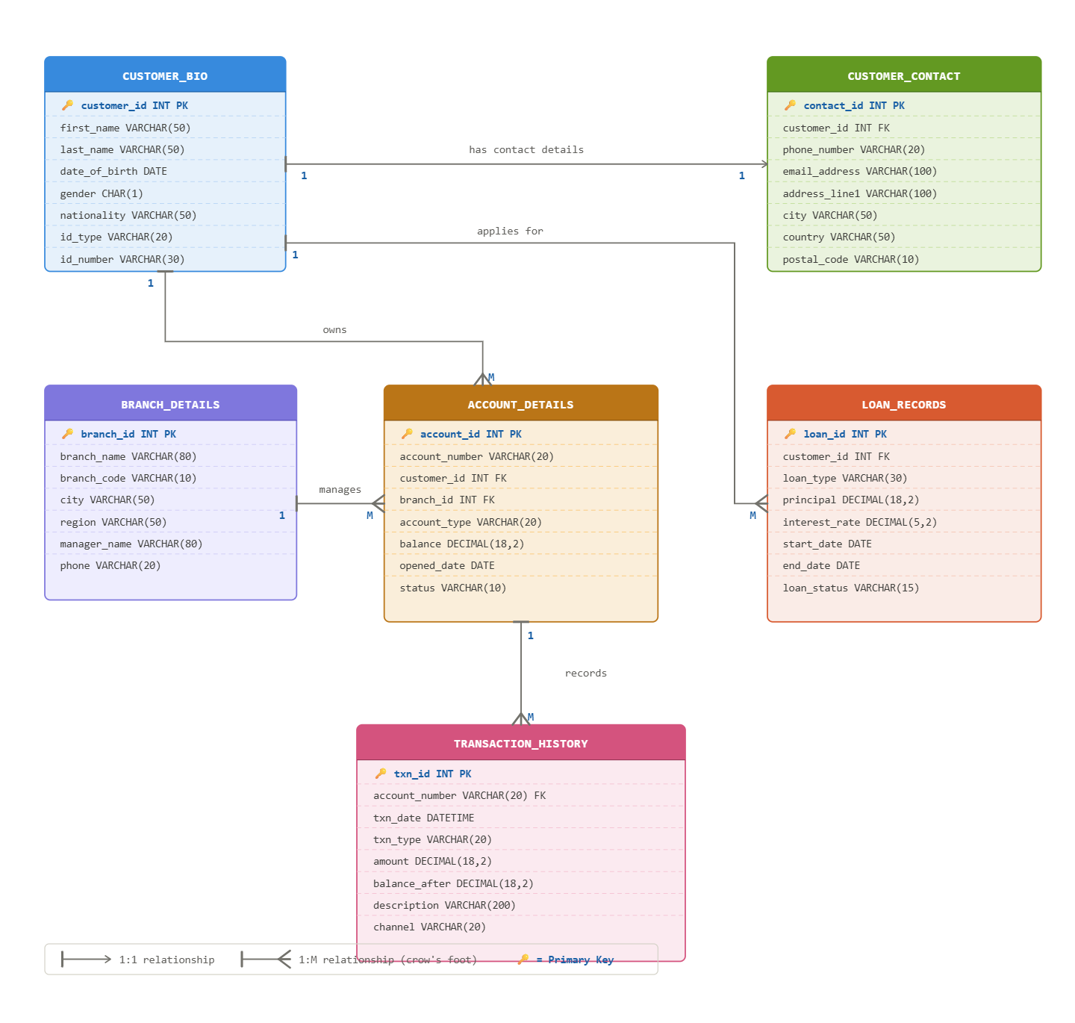
ER DIAGRAM FOR A CUSTOMER DETAILS DATABASE MANAGEMENT SYSTEM

